Slide 1

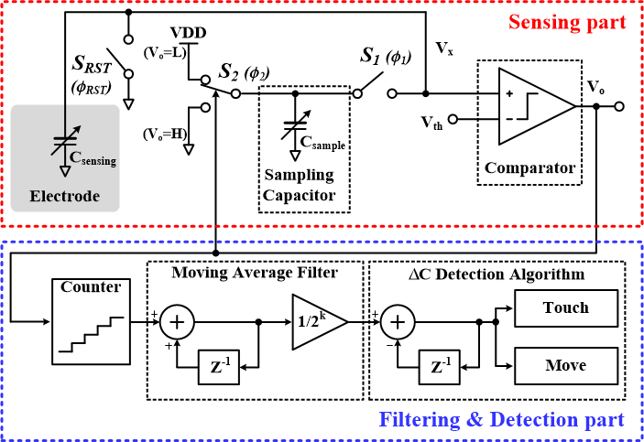
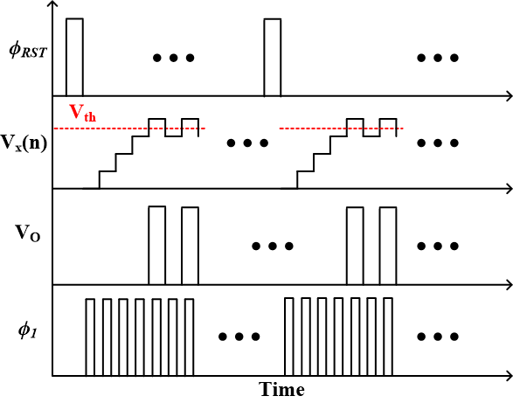
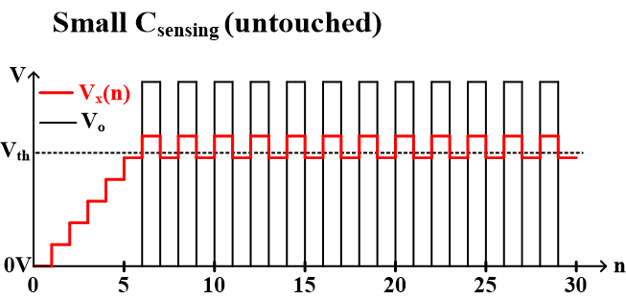
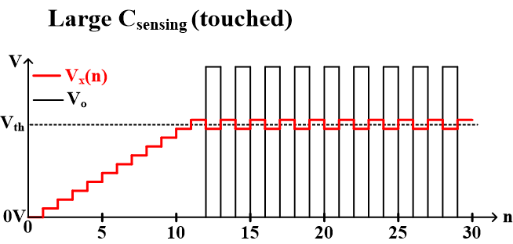
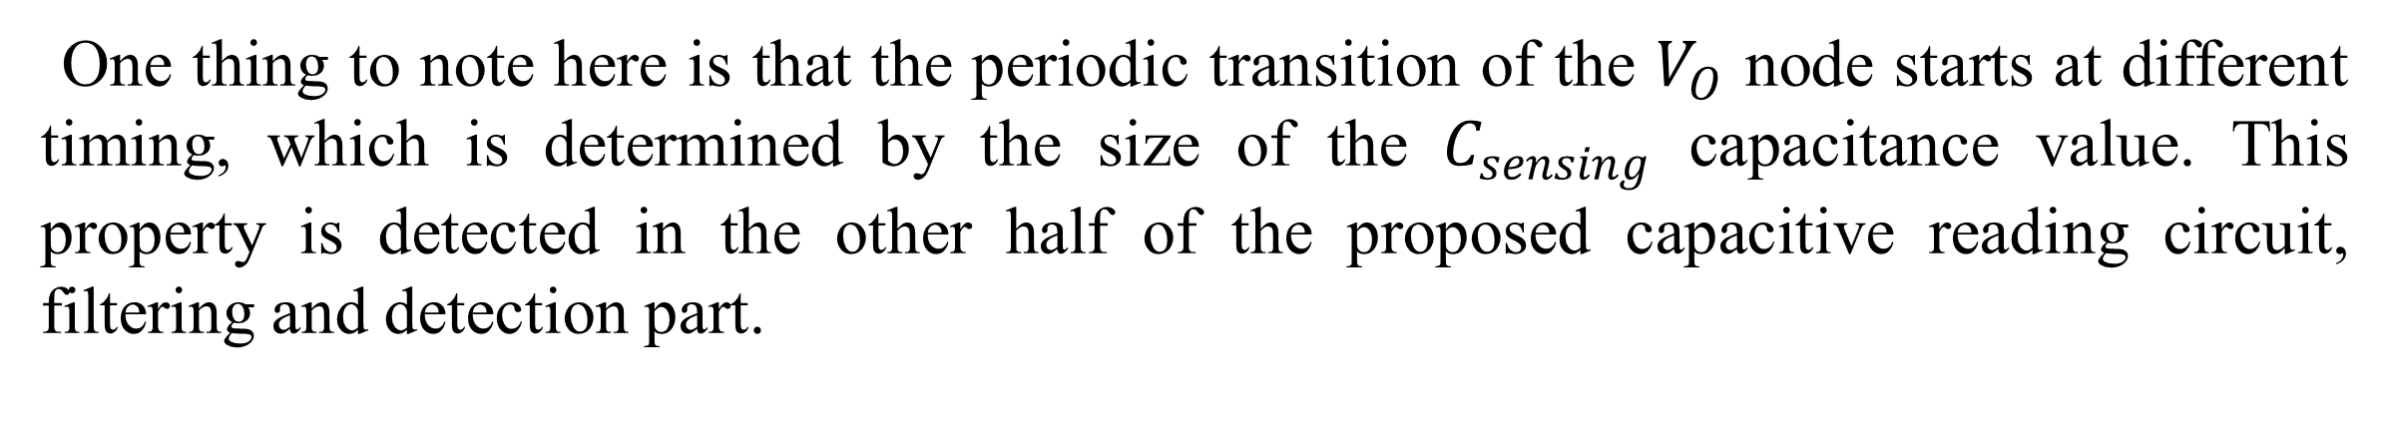


Noise Immunity-Enhanced Capacitance Readout Circuit with Digital based Moving Average Filter
Dong-Hyun Shin, Chung-Hee Jang and Kwang-Hyun Baek
Department of Electrical and Electronic Engineering, Chung-Ang University
E-mail : kbaek@cau.ac.kr
Introduction
One thing to note here is that the periodic transition of the $V_{O}$ node starts at different timing, which is determined by the size of the $C_{sensing}$ capacitance value. This property is detected in the other half of the proposed capacitive reading circuit, filtering and detection part.
The future healthcare system needs wearable devices or implantable devices to monitor human activity. To transmit and receive information through capacitive coupling, the most intuitive way is to touch a device that includes a capacitance readout circuit. Capacitance detection has two main techniques: 1) Capacitance-to-Time (C-T) transformation and 2) Capacitance-to-Voltage (C-V) transformation. The capacitance-to-digital converter using C-T conversion technique is based on period modulation that converts the detected capacitance into different pulse width using oscillators. However, oscillator frequencies are sensitive to supply voltage and resolution depends heavily on clock frequencies. Moreover, they consume a lot of power and are therefore not suitable for battery-powered devices. The C-V technique converts capacitance into analog voltages and then analog-to-digital converters convert the analog voltage to a digital signal. However, the inclusion of ADC increases the area and the power consumption of the entire system, which is a disadvantage of this approach despite intuitive operating principles. To overcome the above limitations, this paper proposes an area-efficient and low-power capacitive readout circuit. The main features of the proposed structures are two-folds: 1) The system adopts a low-power digital moving average filter on top of the DSM-based structure. The MAF consists of simple logic gates and performs a low-pass filter operation to mitigate the shortcomings of the DSM-based structure. Digital logic-based architecture naturally produces output results in binary format, so the system does not require area and power-consuming ADCs. 2) This paper proposes a $∆$C detection algorithm that detects a difference between consecutively measured capacitance values. Unlike conventional capacitance detection methods, the $∆$C detection algorithm allows the system to distinguish between human touch and object touch based on simple digital logic gates.
(a)
(b)
Fig. 1. (a) Overall architecture of the proposed capacitance readout circuit; (b) timing diagram.
(a)
(b)
Fig. 2. Sensing mechanism of the capacitance readout circuit for (a) untouched case; (b) touched case.
K-means clustering unit
The overall architecture of the proposed capacitance readout circuit is shown in Fig. 1(a). The capacitance readout circuit consists of 1) the Sensing part (top red box) and 2) the Filtering & Detection part (bottom blue box). The sensing part includes an electrode (touching pad) with a $C_{sensing}$ capacitor, a sampling capacitor $C_{sample}$, a comparator of an output node, and necessary switches ($S_{1}$, $S_{2}$, and $S_{RST}$). The purpose of the sensing part is to detect changes in capacitance of $C_{sensing}$ based on charge sharing between $C_{sensing}$ and $C_{sample}$. The basic operation of the sensing part is shown in the expected waveforms in Fig. 1(b). Initially, the reset switch $S_{RST}$ turns on and discharges the $C_{sensing}$ capacitance, so the node voltage $V_{X}$ becomes the ground level. The $V_{X}$ level is continuously compared to the threshold voltage level at the comparator negative input. Since the initial $V_{X}$ level is less than $V_{th}$, the output of the comparator $V_{O}$ is lowered. The low-level $V_{O}$ signal charges the $C_{sample}$ capacitor by connecting the switch $S_{2}$ to the VDD level. At the same time, the switch $S_{1}$ periodically connects the $C_{sample}$ capacitor and the $C_{sensing}$ capacitor based on the internal clock pulse ($Φ_{1}$). Whenever the $Φ_{1}$ signal is high, charge sharing occurs between the two capacitors, increasing the voltage of the $V_{X}$ node until it reaches the $V_{th}$ level. Once the $V_{X}$ node voltage exceeds the $V_{th}$ level of the comparator, then the $V_{O}$ output signal becomes high, which switches the connection of the $S_{2}$ switch from VDD to the ground. As a result, the $C_{sample}$ capacitor is discharged to the ground level, and the $V_{X}$ node is reduced through charge sharing when the clock signal $Φ_{1}$ is ‘H’.
Based on the abovementioned feedback operation of the sensing part, two possible scenarios of sensing small/large capacitance of $C_{sensing}$ are illustrated with the relevant waveforms in Fig. 2. Here the magnitude of capacitance mimics the situation where the electrode (touchpad) is sensed by a human or by an object, and the capacitance has been changed to some value (ΔC). The x-axis is the number of cycles (in terms of clock pulse $Φ_{1}$) and shows how the voltage levels of the $V_{X}$ and $V_{O}$ nodes change. For small (large) $C_{sensing}$ values, the $V_{X}$ node reaches the $V_{th}$ level within relatively short (long) cycles as shown in Fig. 2(a) (Fig. 2(b)). Here, it is worth noting that when the $V_{X}$ node reaches $V_{th}$, the output voltage $V_{O}$ of the comparator becomes a periodic pulse due to the negative feedback control loop of the sensing part.
Measured Results
(a)
(b)
(c)
Fig. 3. The MAF data of (a) movement interaction; (b) object detection; (c) human interaction while object is on the electrode.
(a)
(b)
Fig. 4. Capacitance readout circuit output waveforms when (a) object is on the electrode; (b) finger touches the electrode.
Acknowledgment
The chip fabrication and EDA tool were supported by the IC Design Education Center (IDEC), Korea.

